Slide 1
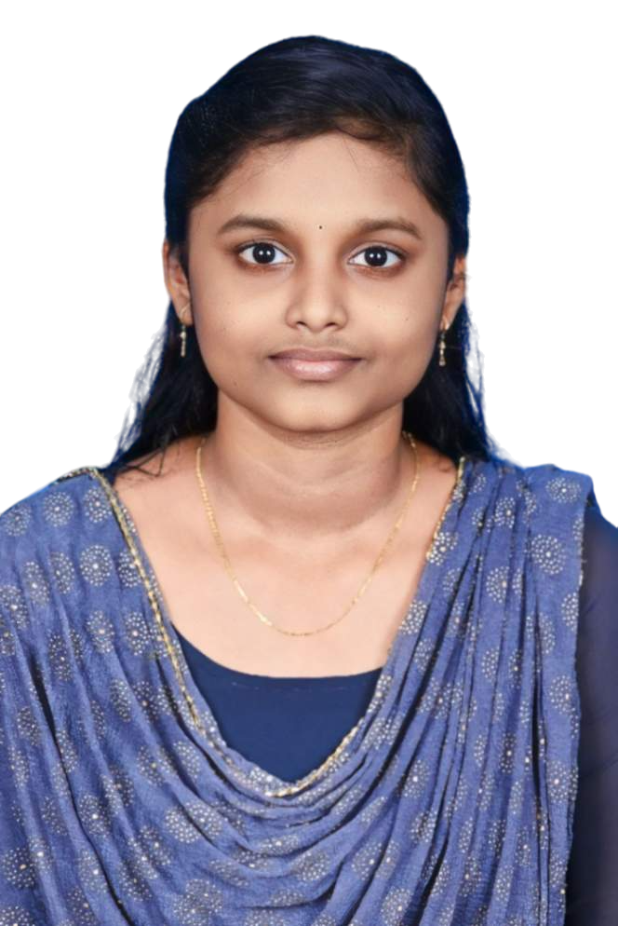
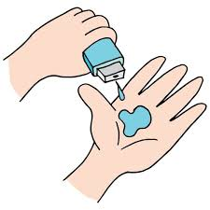
IMAGE RECOGNITION MODEL
PRESENTED BY
STUDENT NAME: ISWARYA V S
COLLEGE NAME: BHARATH INSTITUTE OF
SCIENCE AND TECHNOLOGY
DEPARTMENT: B.Tech INFORMATION TECHNOLOGY
EMAIL ID: iswaryagms12@gmail.com
AICTE STUDENT ID: STU6797aec197b831737993921

Slide 2

PROBLEM STATEMENT
"In today’s digital world, classifying and recognizing objects in images quickly and accurately is a crucial task for applications like security systems, medical imaging, and e-commerce. However, building high-accuracy models from scratch can be computationally expensive and time-consuming."

Slide 3
PROPOSED SYSTEM “To address this issue, we developed a lightweight image recognition system using a pre-trained MobileNetV2 model, which provides accurate predictions with lower computational overhead. The model is deployed as a web app where users can upload images and get predictions instantly.”

Slide 4

TECHNOLOGY USED
Model: TensorFlow Keras (MobileNetV2 pre-trained on ImageNet)
Frontend & Backend: Flask (Python Web Framework)
Model: TensorFlow Keras (MobileNetV2 pre-trained on ImageNet)Entrepreneurs
Image Handling: NumPy,PIL
Hosting/Deployment: Localhost

Slide 5

Algorithm & Deployment
Image uploaded via web interface.
Preprocessing: Resize and normalize the image.
Model loads MobileNetV2 with ImageNet weights.
Prediction: Output top 3 labels with confidence scores.
Deployment: Flask app runs locally to accept and display results.

Slide 6
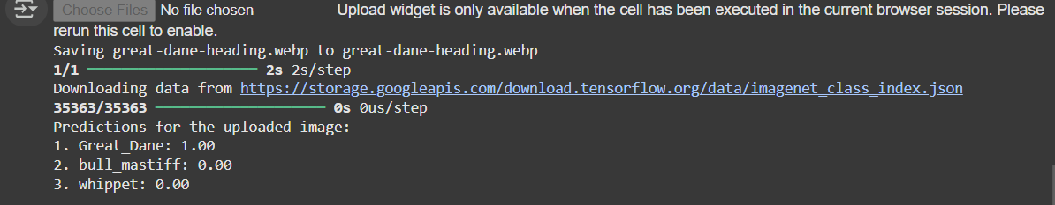
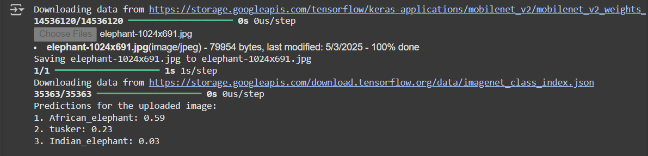
RESULTS
Image Recognition Model
https://github.com/Iswarya-1705/Recognition_Model

Slide 7
CONCLUSION
This system demonstrates how pre-trained models can be effectively reused for real-world applications without the need for large training datasets or expensive hardware. The lightweight MobileNetV2 model ensures fast and accurate recognition suitable for deployment on limited-resource environments.
.
.

Slide 8
Future Scope
Deploy the app on cloud platforms like Heroku or
AWS.
Add more user interface features like drag-and-drop, image gallery, or prediction history.
Extend model capabilities to handle custom training for domain-specific classification.

Slide 9
References
TensorFlow MobileNetV2 Documentation
Flask Web Framework Official Docs
ImageNet Dataset
NumPy & PIL Python Libraries

Slide 10
THANK YOU
Special thanks to Edunet Foundation Internship Program
for providing this opportunity and support.

